Slide 1
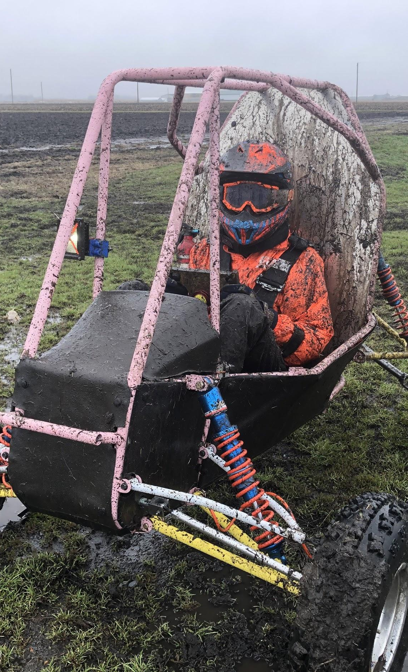

ME 199
4/6/20

Slide 2
Overview
Working on design slides
  Competition delivery platform is still unknown
  Slides are format-less so we can at least get important information on the page
  Stay tuned for updates
2021 4WD project assignments pending
  Ask your new sub-team lead or Jack/Adam/Katie if you have questions

Slide 3
Upcoming Due Dates
Friday April 10 (Midnight): Wiki updates done and uploaded
  Please do these as soon as possible
  Late or poor work will negatively affect your 199 grade
    We have given 3 weeks to complete this
  Message old sub-team lead or Keira if you need edit permissions
Friday April 17: FMEA
  Check your sub-team channel for message from Becca

Slide 4
Subteam Updates

Slide 5
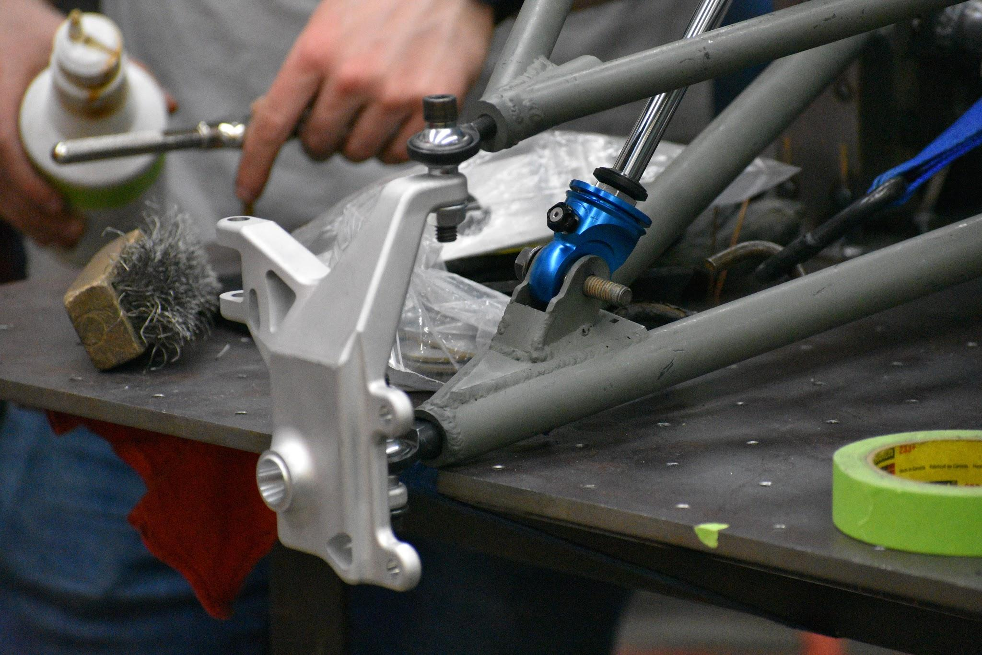
Suspension
Wednesdays at 3pm
Zoom Meeting
199 projects due April 15th
  Check in on Wednesday
Design slides being put together
  Keep an eye on slack for messages asking for your help
Transition to 4WD work after the 15th
  Saab will take over subteam meetings
  Fill out project interest form
Preliminary 4WD points being sent out within the next two weeks

Slide 6
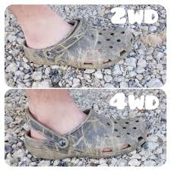
Drivetrain
Wednesdays at 7pm
Zoom Meeting
Sending out subteam meeting slides tomorrow
  Fill out your section Wednesday
Sending out 4WD project interest form this week
Getting ready for virtual comp design presentation
  If you designed a part Adam may reach out to you for more information so be ready
2021 Drivetrain senior design
  Meeting this week to talk specifics

Slide 7
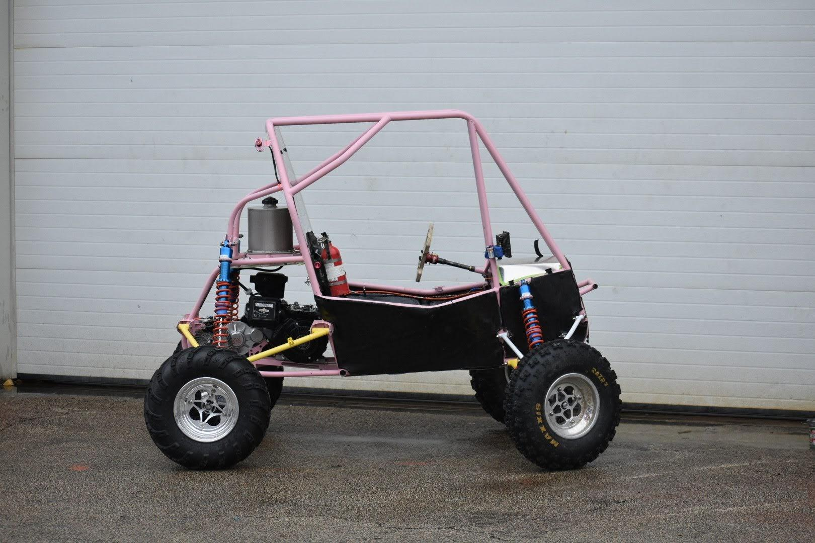
Chassis
Wednesdays at 7pm
Zoom Meeting
Checking on 199 projects on Wednesday
  Tab testing CAD, ramp redesign CAD
Sending out interest form for 4WD projects soon
Putting together design binder for virtual competitions
Continuing to work on 4WD planning
Sam will be taking over meetings soon

Slide 8
Business
No Meeting this Week
Next Meeting: Tues 4/14 at 6:30pm
Miranda working on integrating Josh into the position

Slide 9
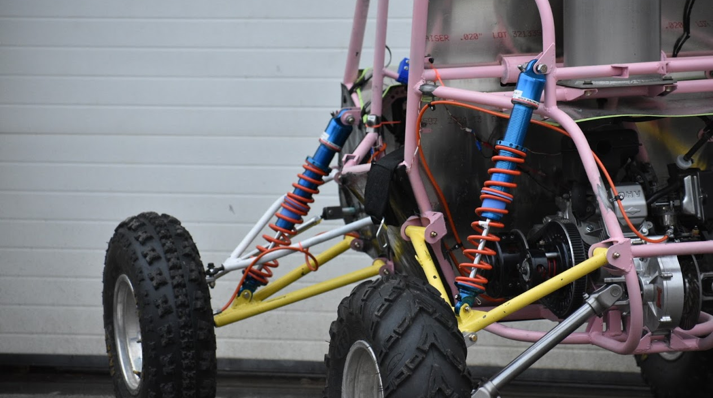
Questions?

Slide 10
ME 199
04.6.20

Slide 11
General Updates
Cost Report was submitted last Monday
  Thanks to all that helped!
Design Report will be submitted tonight
Work is continuing on building simulations for 4WD validation

Slide 12
Subteam Meeting Times
General: Cancelled
Chassis/Suspension: Cancelled
Drivetrain: Cancelled
Aerodynamics: Cancelled
Tractive: Cancelled
DAQA: Cancelled
Mattermost channels will be up to date with any virtual meetings that take place!

Slide 13


MECHANICAL SUBTEAMS
CHASSIS
SUSPENSION
AERODYNAMICS
DRIVETRAIN
INTEGRATION

Slide 14
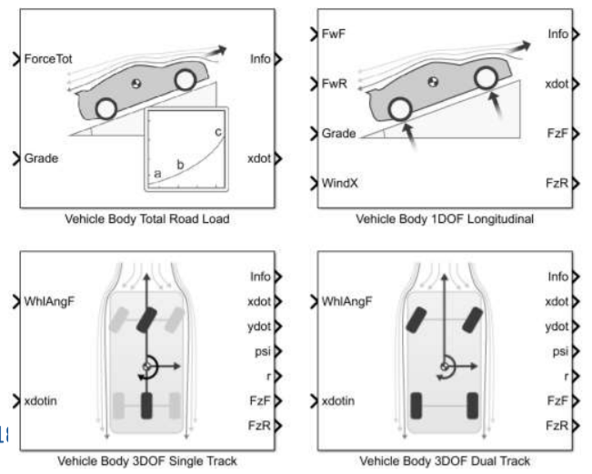
Chassis/Suspension
Kush Patel
kushrp2@Illinois.edu
Last Week
Finished cost report
Discussed necessary inputs and outputs for the suspension side of lap sims
This Week
Continue working on TTC Analysis
  Get numbers to use in Pacejka’s Magic Formula
Set up preliminary car model for lap sims with general assumptions and simplifications
  Will be designed to easily adjust and improve with more complex and accurate equations and look up tables
Begin looking at upright design and packaging in a 4WD car
Revaluate ME199 project assignments
  I will be contacting you directly about this
Finish design report

Slide 15
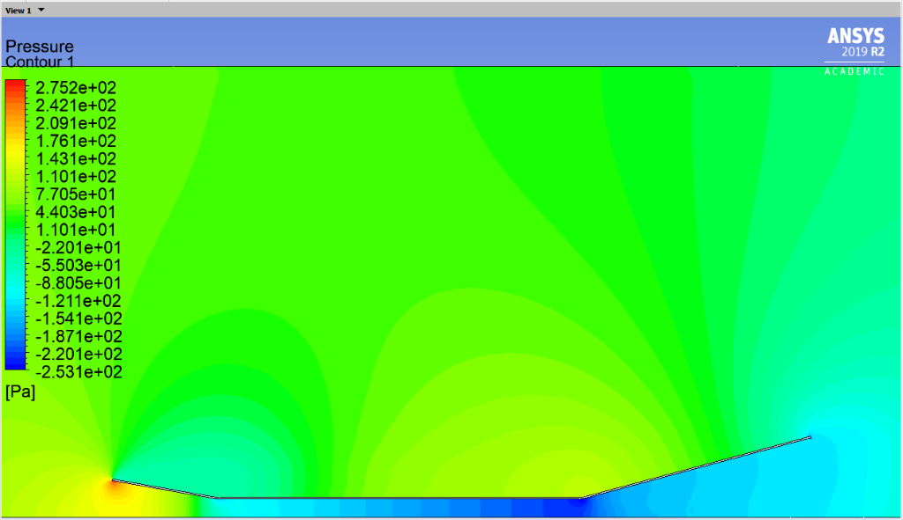
Aerodynamics
Carson Trpik
ctrpik2@illinois.edu
Last Week
Finished cost report
Looked into incorporating aero into lap sims
This Week
Help with lap sim setup
  Find which subsystems need aero inputs
  Find which inputs aero needs to be accurate
Begin preliminary aero designs

Slide 16
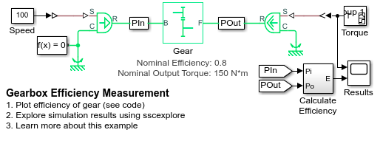
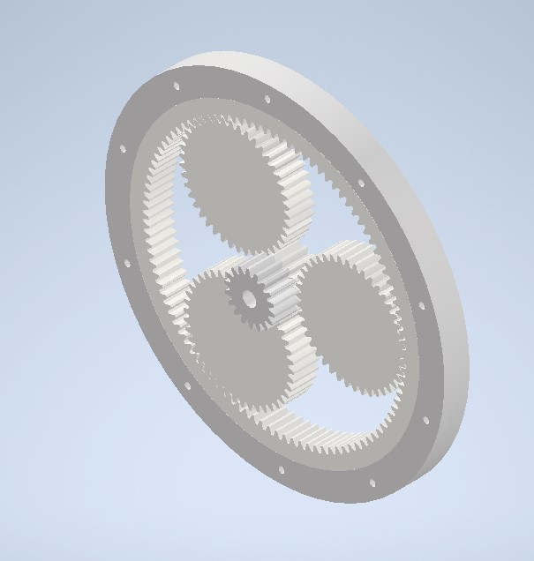
Drivetrain
David Lam
wj6@illinois.edu
Last Week
Created outline for drivetrain simulation components
Rough gearbox created in Inventor thanks to Rishi
This Week
Complete drivetrain model and code for first lap sim
Start gearbox CAD in Solidworks

Slide 17
Integration
Rishi Taparia
taparia2@illinois.edu
Last Week
Assisted with lap sim setup
Created rough layout of potential planetary gearbox
This Week
Research cooling solutions
Read rules to see limitations on accumulator and HV wiring

Slide 18


ELECTRICAL SUBTEAMS
TRACTIVE
DAQA
MOTORS
CONTROLS

Slide 19
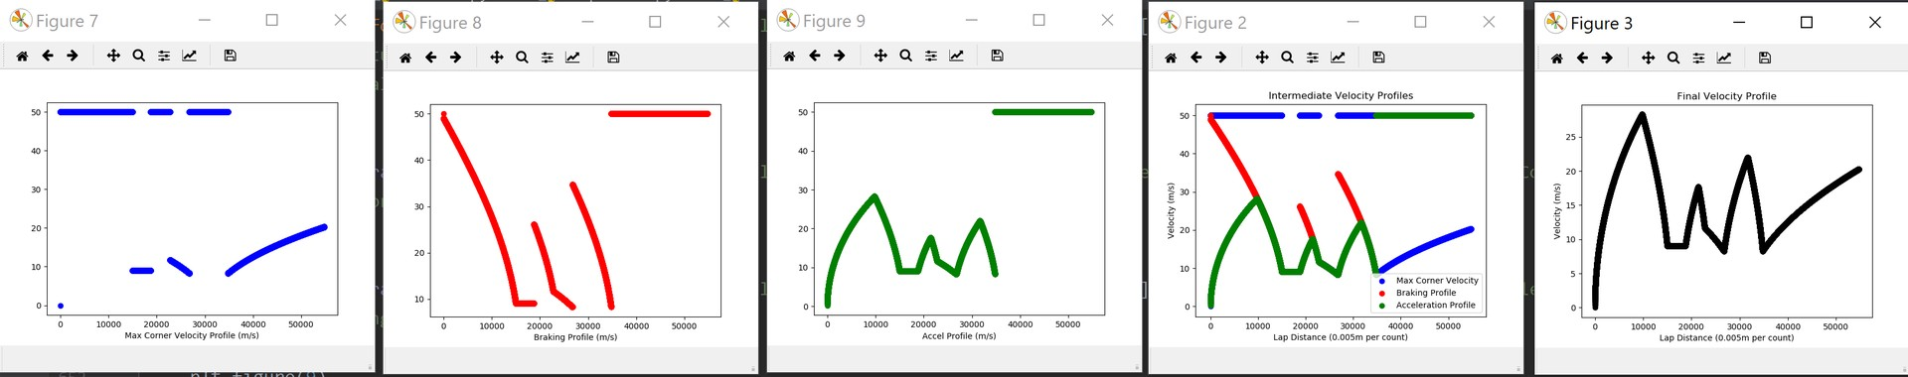
Tractive System
Evan Chen
evanc4@Illinois.edu
Last Week
Lap sim research/planning
This Week
Design report, spec sheet
Implement quasi-static simulator and mechanical modules

Slide 20
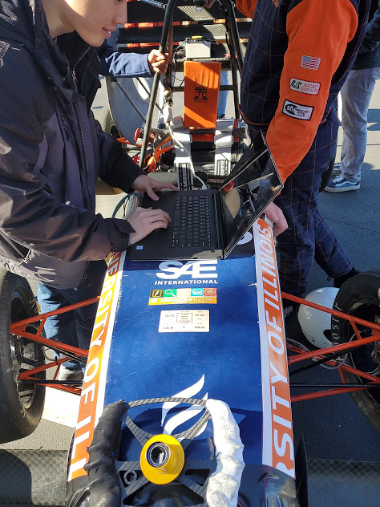
Data Acquisition
Joe Lopez
Joseal2@illinois.edu
Last Week
Sensor fusion trials from 2019 car data
Design report
Board redesign
This Week
Complete board redesign
Continue sensor fusion

Slide 21
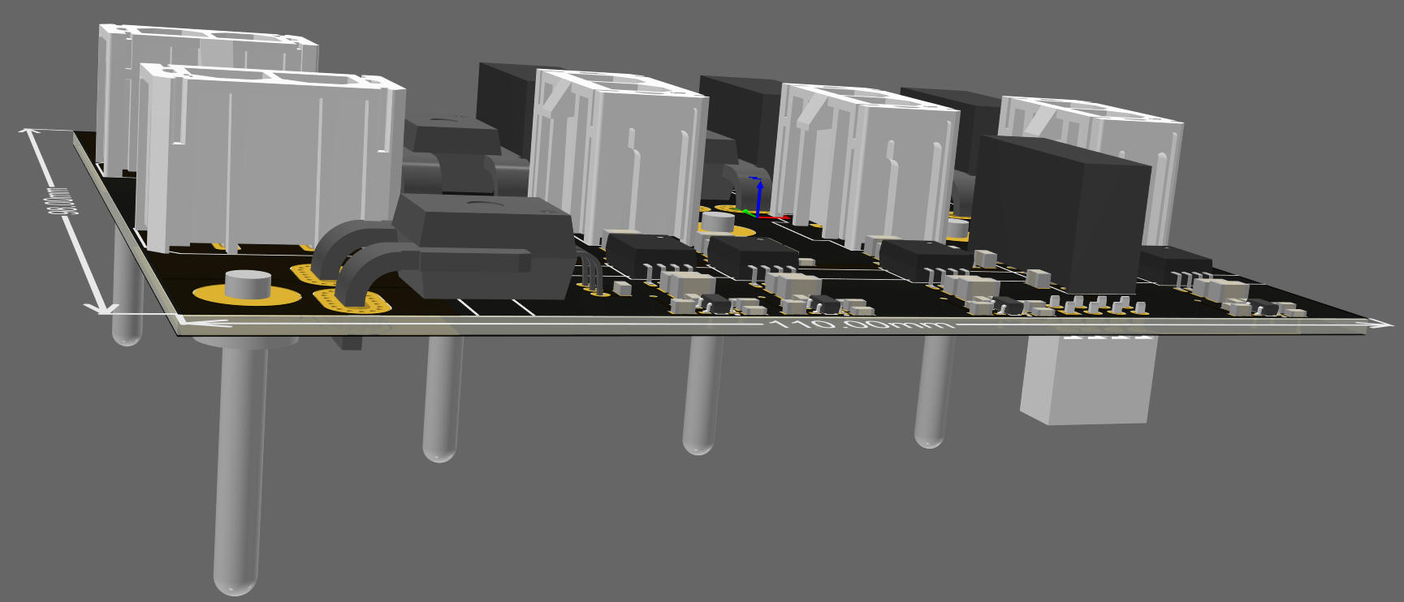
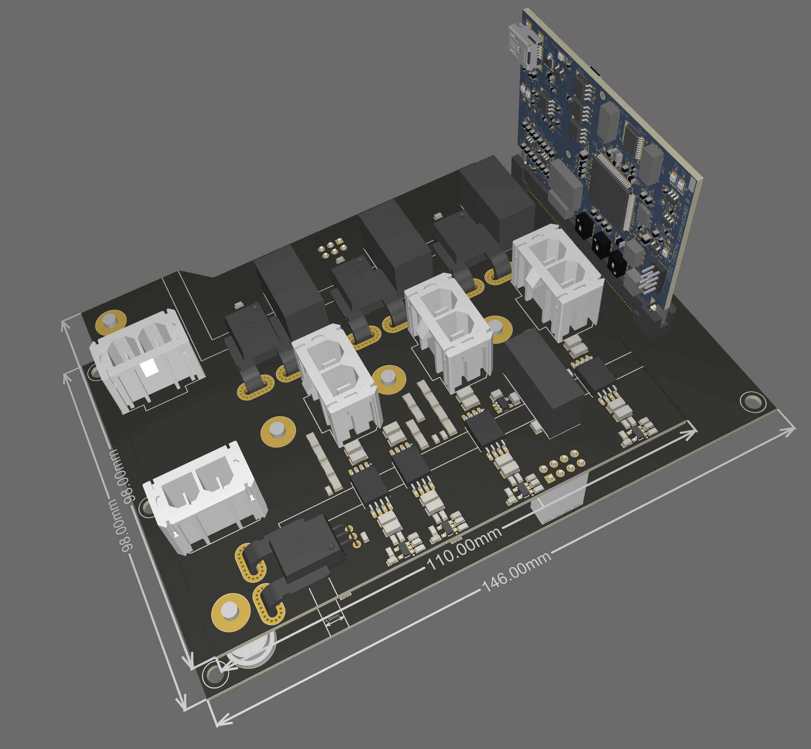
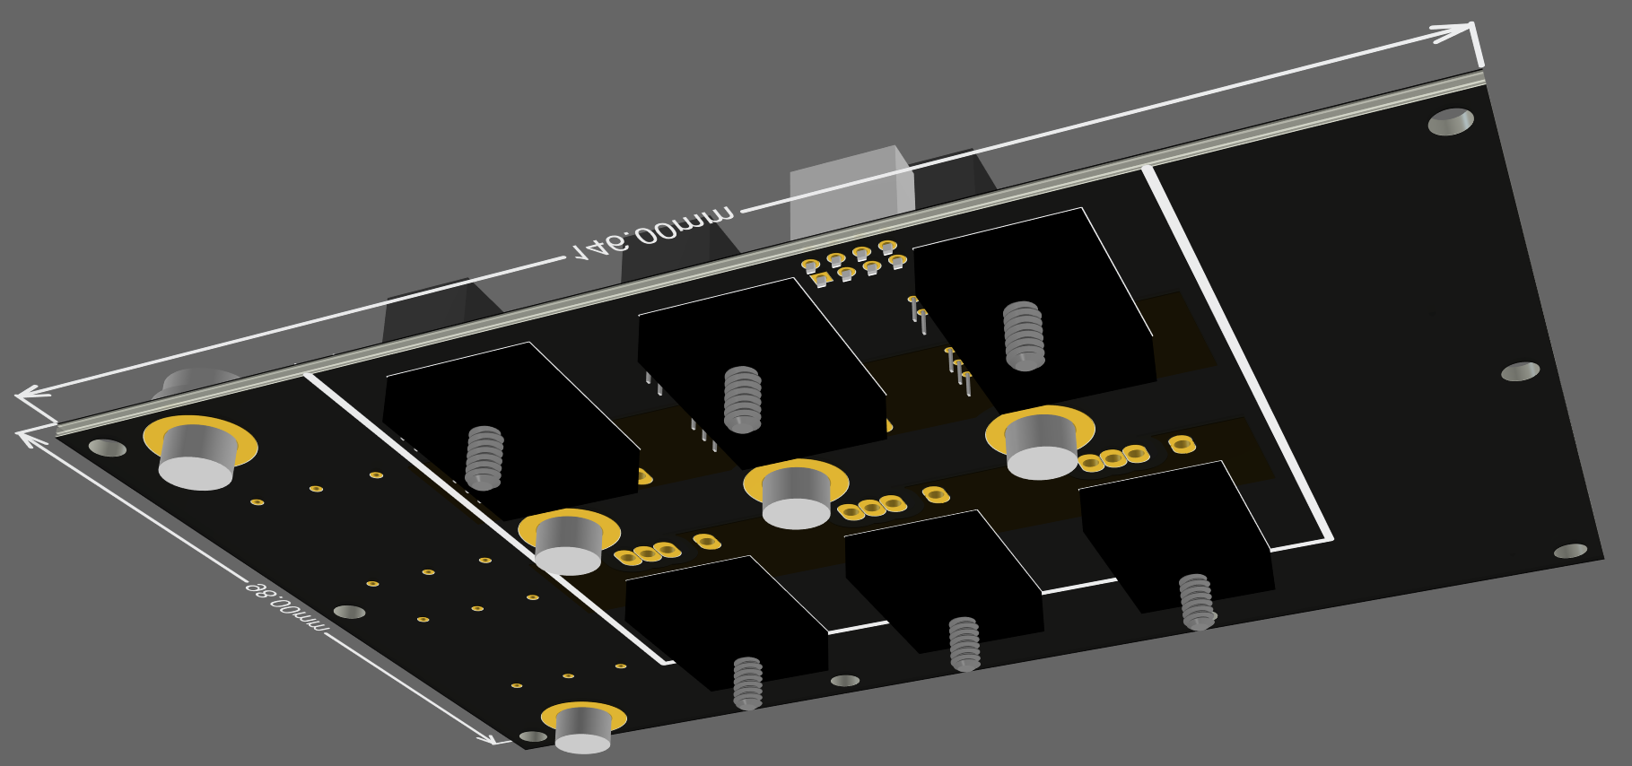
Motors/Controls
Chaitanya Sindagi
sindagi2@illinois.edu
Last Week
Overall Assembly completed
  Connector choices finalized
  Component layout finalized
Simulations for thermals verified using CREE SpeedFit
This Week
Complete Output Sensing Board and Power Stage layout
  Finalize component choices
  Optimum signal routing for sense signals
  Connections to control card and pin assignment based on reference designs
  Polygon current rating and copper thickness to be verified using PDN

Slide 22

BUSINESS SUBTEAM

Slide 23
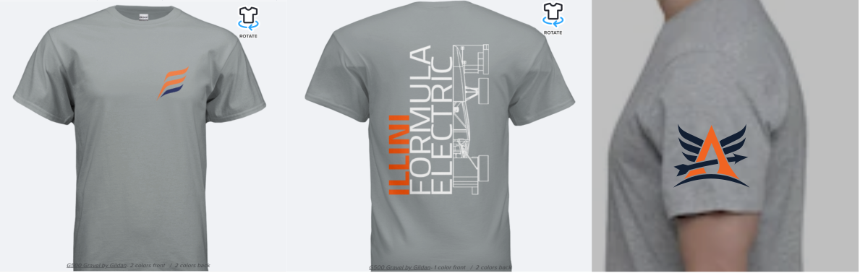
Business
Last Week
Researched information for business presentation
Had difficulties in getting the necessary information to put in a t shirt order
This Week
Sending out order form
  Check @General for the order form
Continue researching for business presentation
Create barebones presentation

Slide 24
QUESTIONS?

Slide 25
ME 199
4/6/20

Slide 26
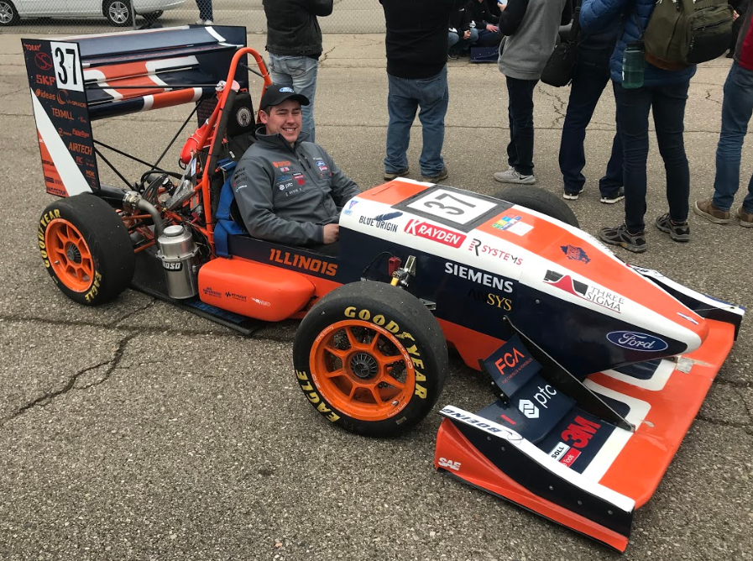
Tanner Bergner
Mechanical Engineering 2020
Joined Illini Motorsports in Spring 2018
Involvement
  Engine Project Lead 2019-2020
  Engine Member 2018-2020
  Aerodynamics Member 2017-2018

Slide 27
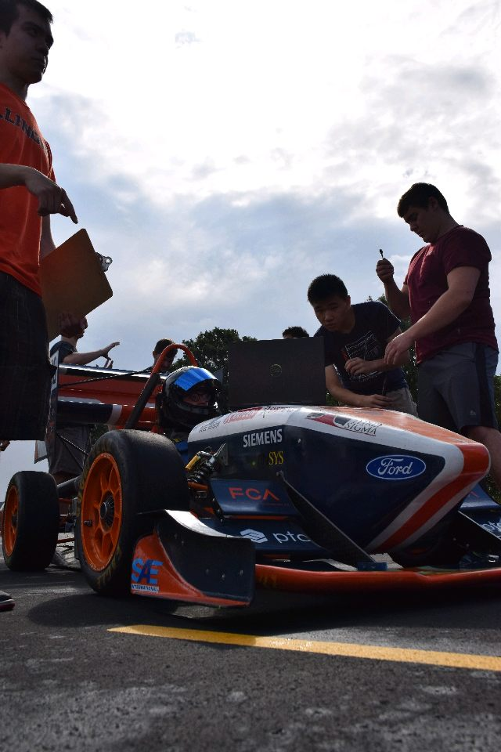
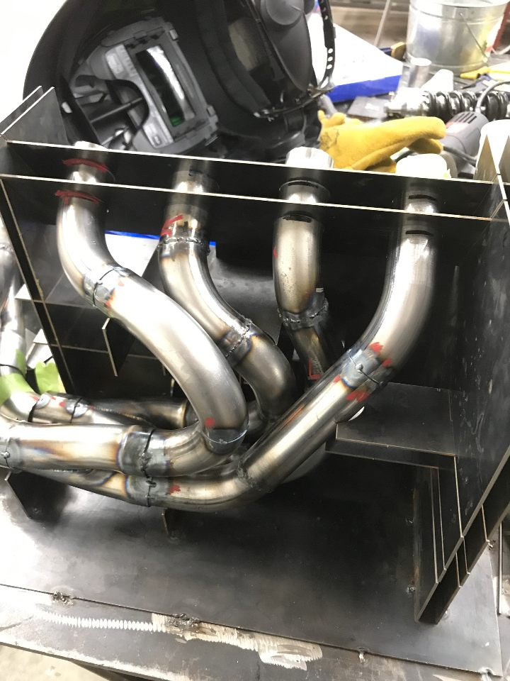
Engine Member
Helped manufacture exhaust system
Researched Silencer and did CFD
Helped with Engine Tuning
Helped create radiator shroud
Designed protection and better intake for radiator

Slide 28
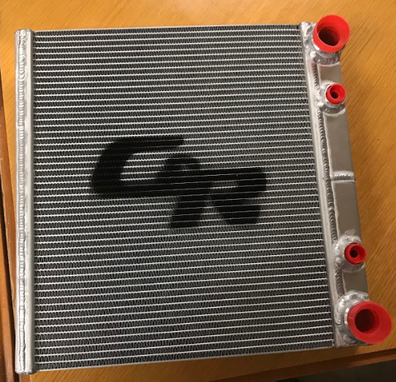
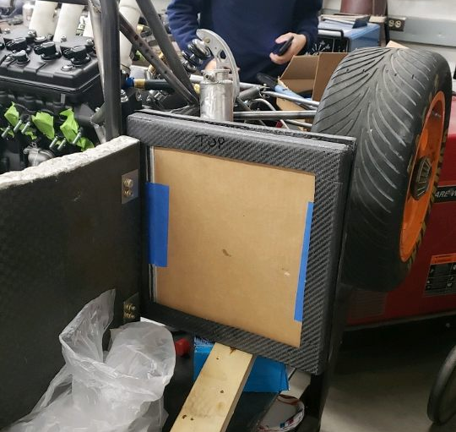
Engine Project Lead
Researched collected data and manufactured cooling system
Implemented new way to compare our radiator on an effectiveness to Heat Tranfer Units scale
Designed tests for heat generation of engine
Designed test for temperature change in radiator according to engine tune

Slide 29
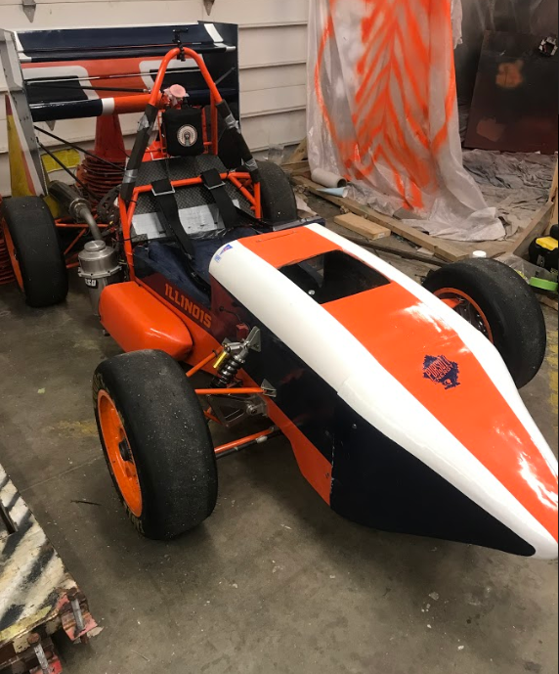
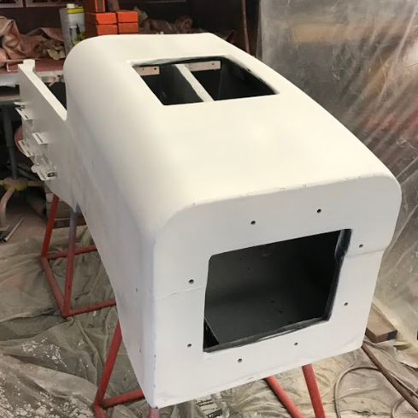
General Team Work
Painted 2018-2019 Car
Helped choose livery and tape off design for car
Helped Sand aero and monocoque components for paint
Painted A-arms with rust resistant paint

Slide 30
Etai Schnitman

Slide 31
Team Contributions
Rear Anti-Roll Bar
  Designed the lever arms
    Purpose: to transfer load from the drop links to the torsion spring inside the anti-roll bar
Rolling Car
  Lots of machining on the lathe
    Inserts, spacers, and other parts of varying complexity
  Helped with final assembly of the car
    Sanding, corner assembly, drive pin insertion into uprights, etc.
  Created DXFs for waterjetted parts

Slide 32
Skills Acquired
CAD intuition
  Learned how to edit geometry and dimensions so they can be easily changed in the future
  Learned how to copy geometry from an assembly or an existing part
  Learned how to take forces and torques into account when editing geometry
FEA skills
  Learned how to set up a static structural analysis in ANSYS
    Intelligently constraining the part so that the simulation is more true-to-life
    Adding in forces and moments in the correct locations
    Adding fine mesh near stress concentrations and coarse mesh where the stress in the part remains uniform
  Learned how to use the stress and deformation results from ANSYS to edit CAD in Creo

Slide 33
Skills Acquired (Continued)
Manual Lathe Operation
  Learned how to discern which RPM and traverse speed to use, which depends on:
    The diameter of the part
    The workpiece material
    The cutting material
    The type of tool
  Lots of practice with hitting dimensional tolerances
    Extensive practice using calipers (dial and electronic), micrometers, and bore gauges

Slide 34
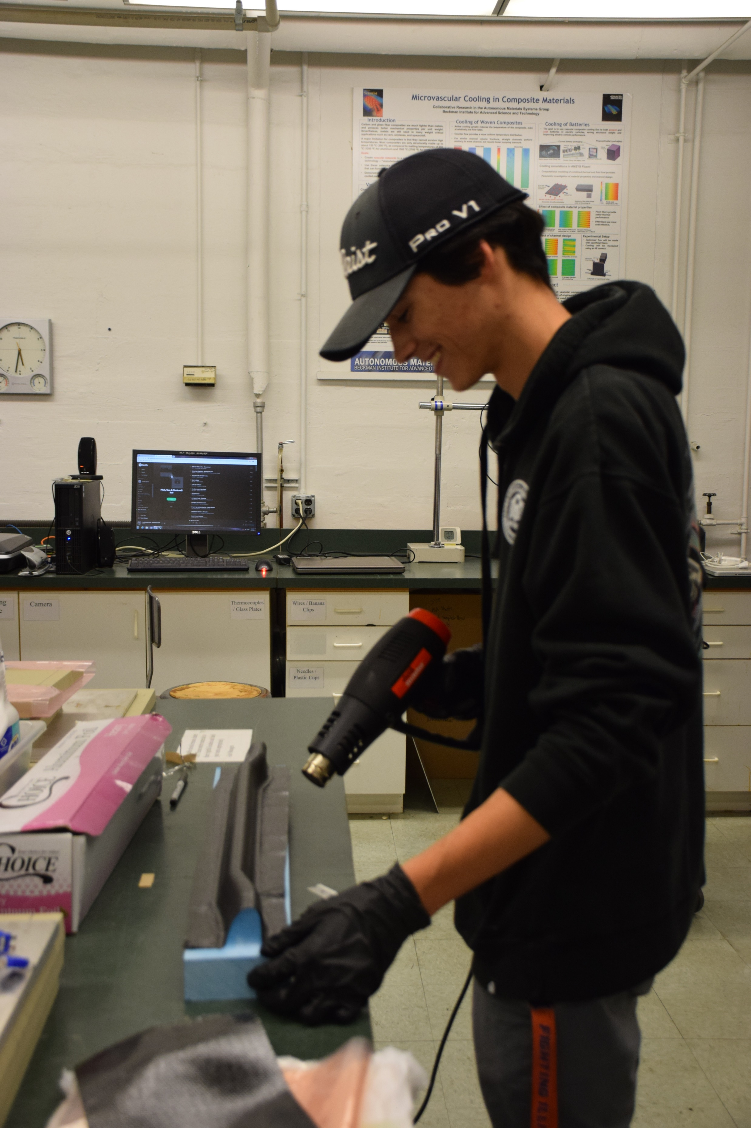
Maverick Emerson
Aerospace Engineering 2022
Joined Illini Motorsports in Fall 2018
Association:
  Aerodynamics sub-team member (2018 – present)

Slide 35
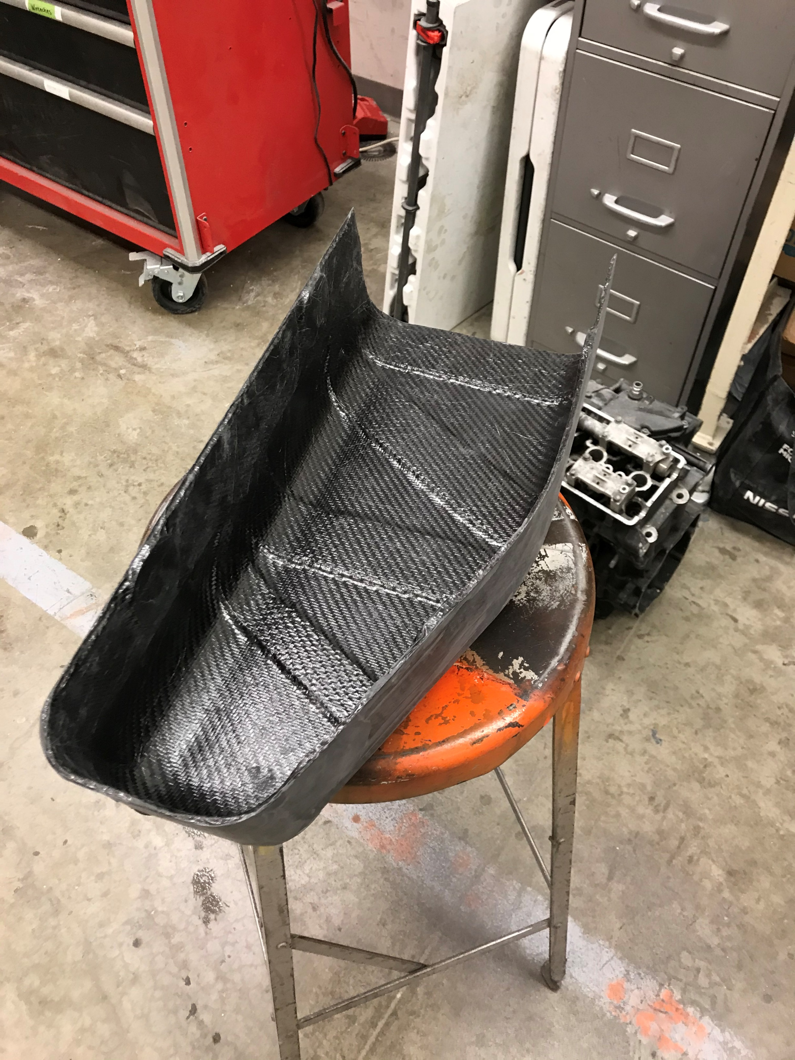
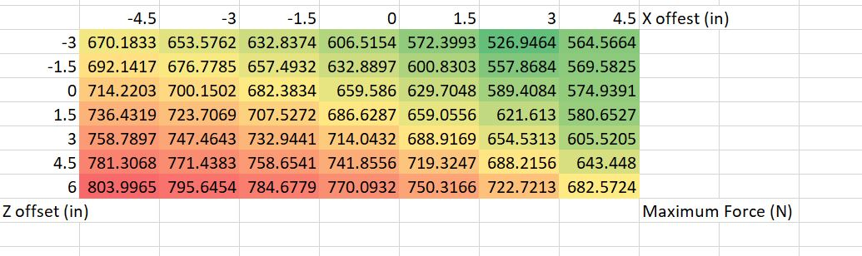
Involvement as an Aerodynamics Member
Created mold CAD for center portion of front wing
main element
Sanding of molds in preparation for layups
Assisted in majority of aero and composites layups
Assisted in post-processing of aero elements
Designed the 2019-2020 E-Cover, along with CAD mold
MATLAB code for rear wing mounting analysis to optimize placement on 2019-2020 car

Slide 36
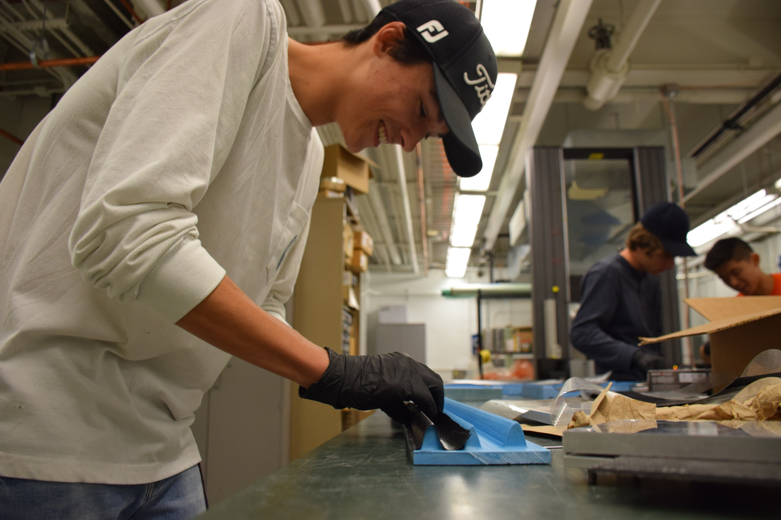
Skills Learned
CAD
  Creo design methods
Coding
  MATLAB
Team Communication
  Design process including working across sub-systems to ensure the E-Cover fit the desired electronics parts inside
Composites manufacturing process
  Mold Preparation
  Layups
  Post-processing

Slide 37
Privith Kumar

Slide 38
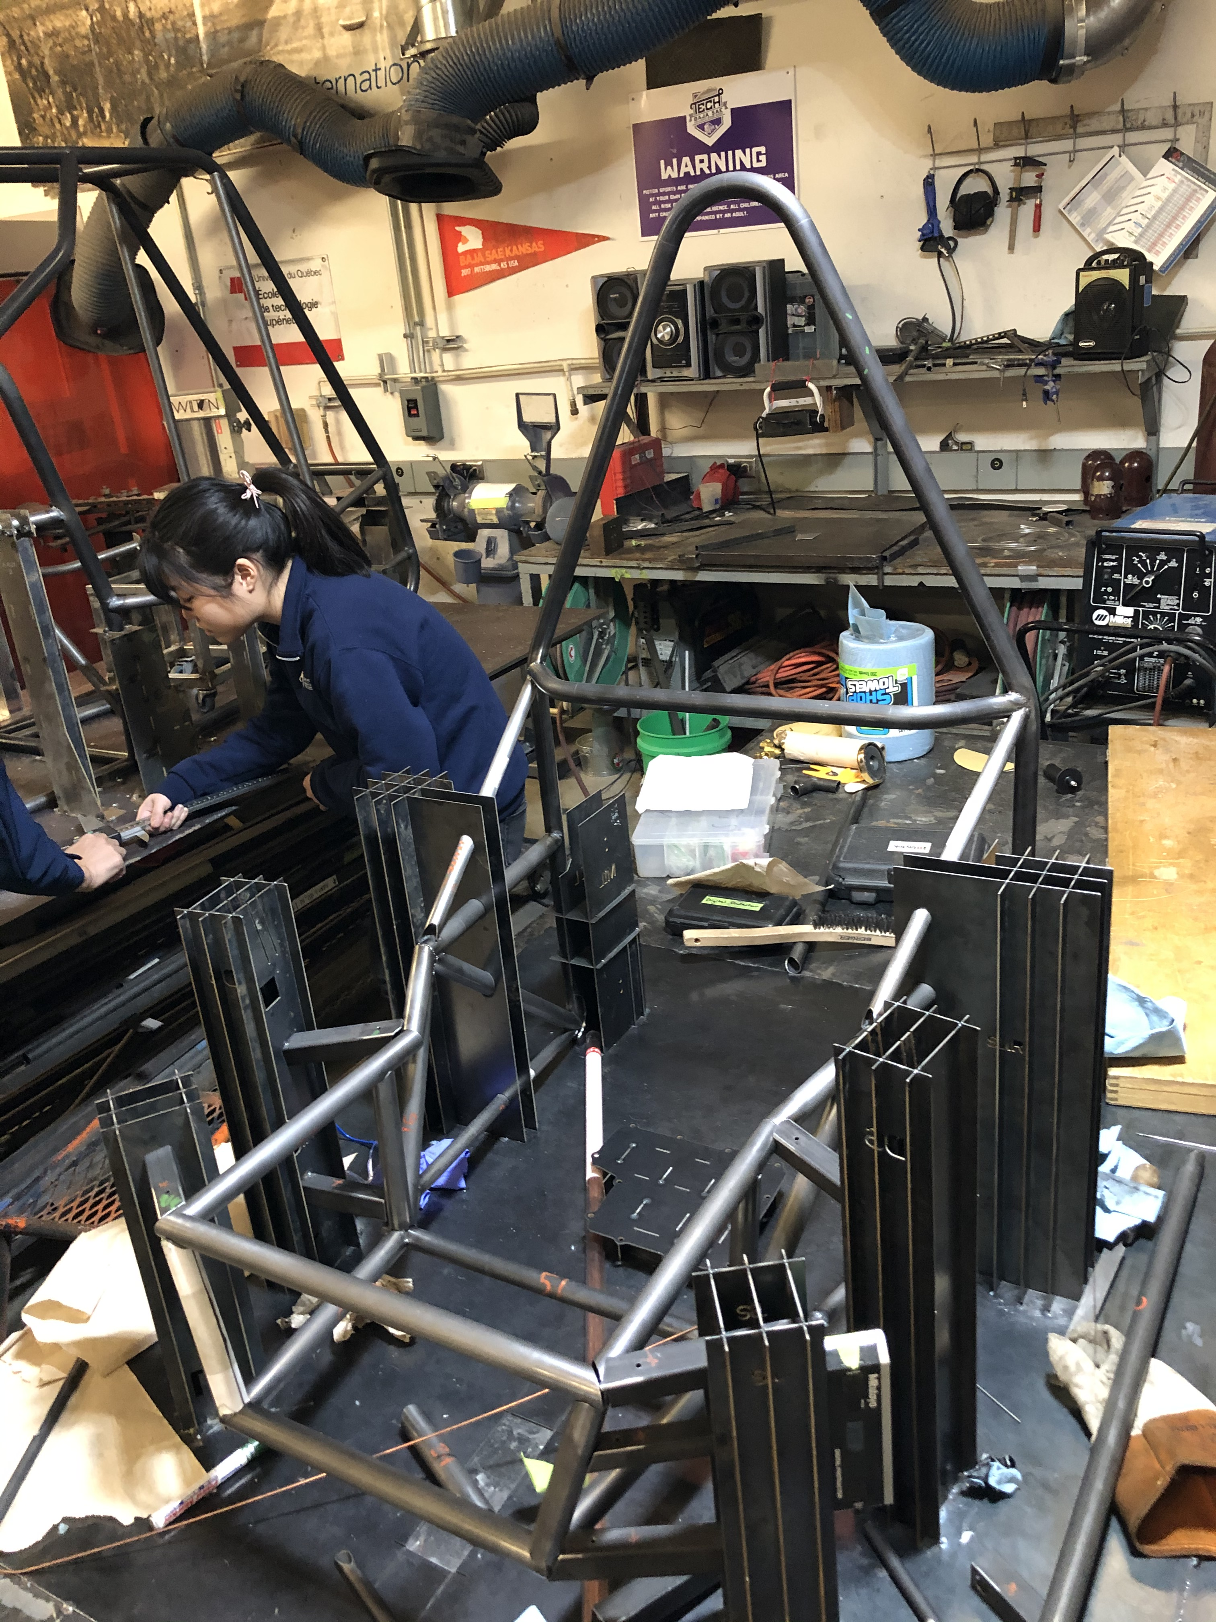
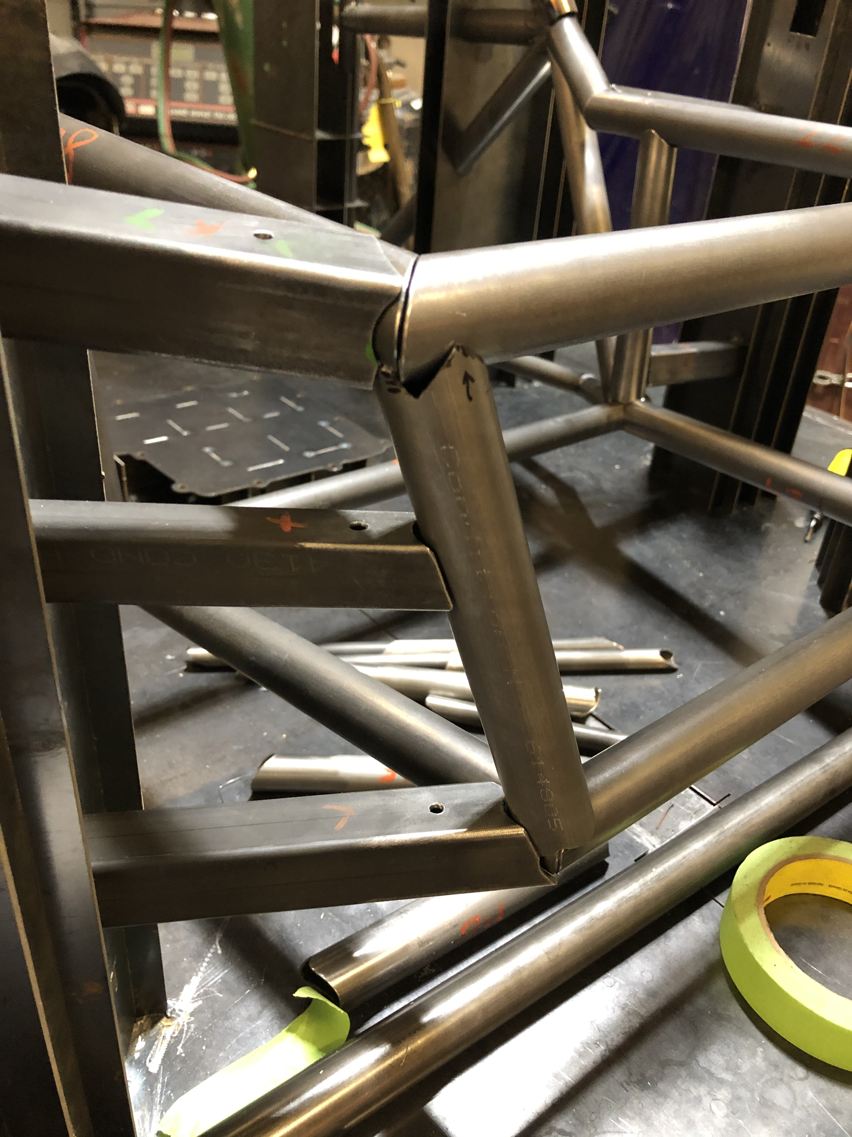
Rear Subframe Assembly
I assisted in the profiling, assembly, and welding of the several steel tubes that make up our rear subframe (RSF).
During the process I learned different ways to work around problems that arise when assembling so many different and sometimes ill-fitting components
I also learned different techniques to convert tube profiles in CAD into usable templates for actual profiling of tubes

Slide 39
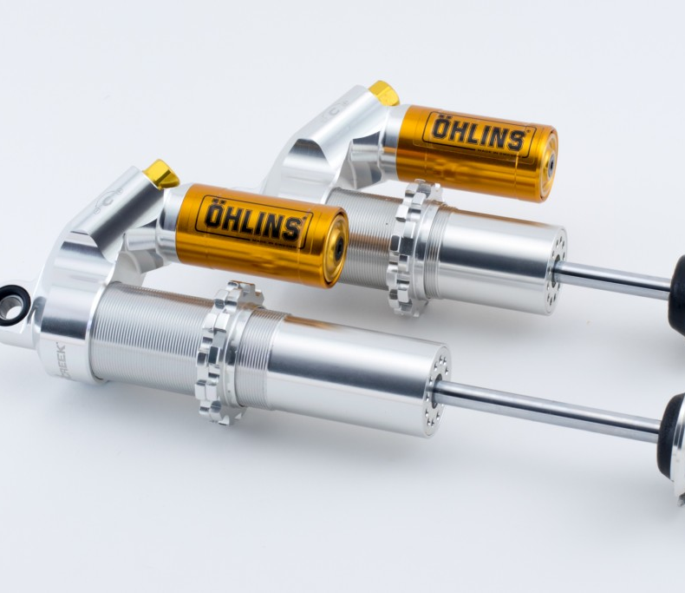
Swapping Dampers
I worked on swapping the Ohlins shocks on last year’s car with spares
I also worked on installing and assembling the bellcranks and old dampers in the new car
We encountered an issue in the damper tabs being misaligned with the bellcranks (this was fixed by resetting the tabs)

Slide 40
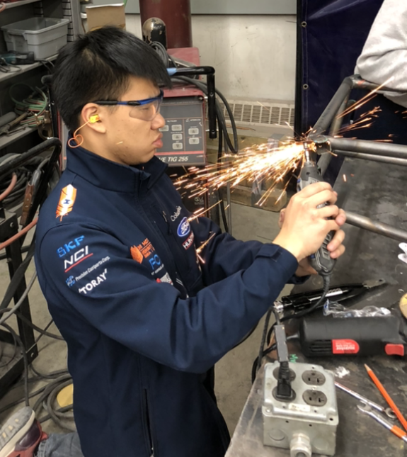
A-Arm Tabs
I supervised the cutting out and grinding of tabs on the rear subframe used to mount A-arms onto the car
This project was important to ensure that the A-arms would not contact the tubes in the rear subframe when in motion
Initially I did not realize how critical it was to leave a certain amount of material on the tabs – I should have taken more accurate measurements of the profiles of the old car’s tabs

Slide 41
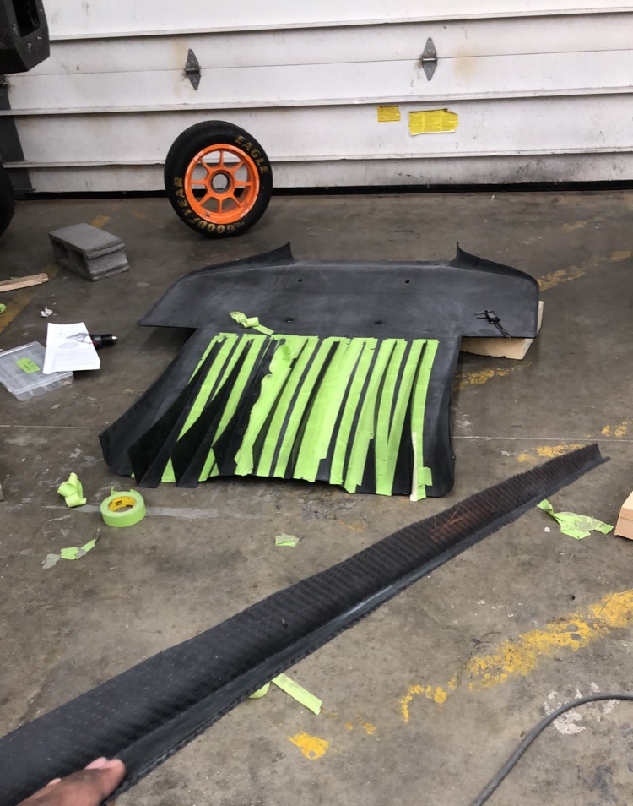
Composite Layups
This semester, we performed several carbon fiber layups, including our endplates and strakes, shown to the left
I directly worked on laying up, sanding, and assembling the strakes
I learned more about the precision required in placing the strakes on the undertray

Slide 42
Steering – Tech Talk
4/06/2020
Rebecca Kasner

Slide 43
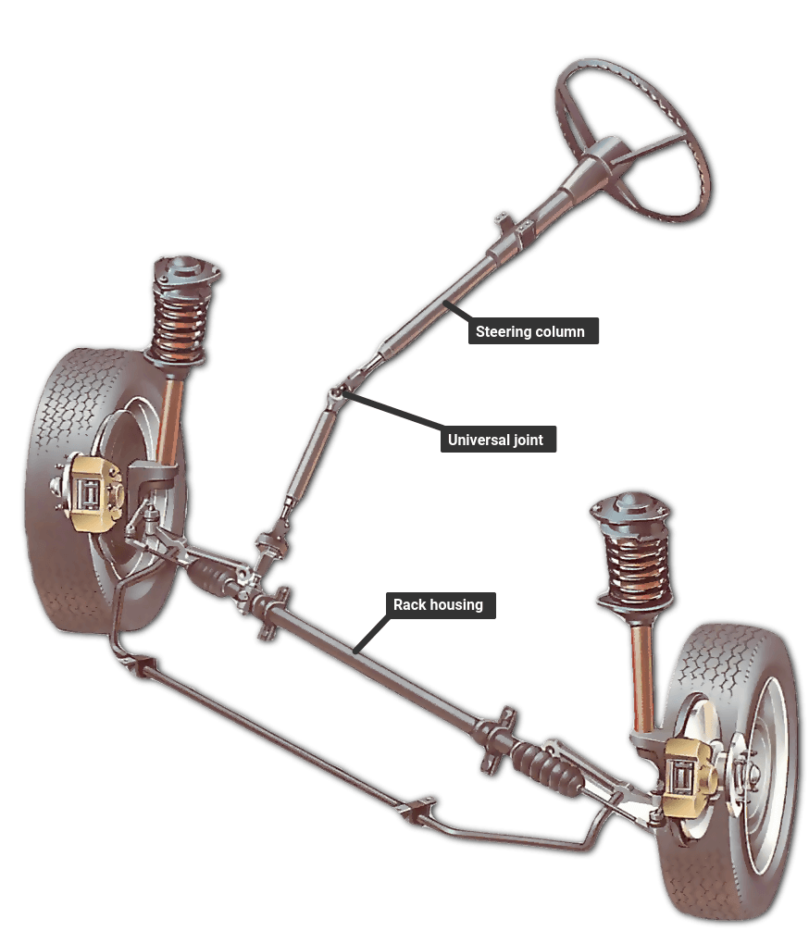
Why It’s Important
Transfers turning of steering wheel to wheel rotation
Good steering “feel”
  Limit required input force from driver to turn wheels
  Low effort, high responsiveness
Desired steering angle reached
Performance based design, many changeable factors for desired output

Slide 44
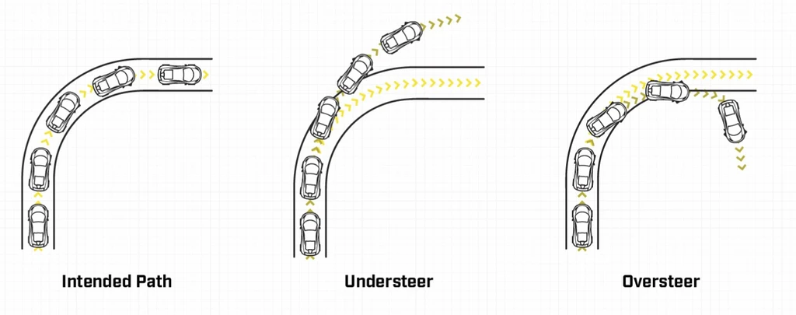
Understeer/Oversteer
Understeer: car turns less than the amount commanded by the driver
Oversteer: car turns more than the amount commanded by the driver
Contributing factors: camber, suspension setups, driven wheels, tire stiffness, driver control, etc.
“understeer is when the front end of your car hits the tree, and oversteer is when the back hits the tree”

Slide 45
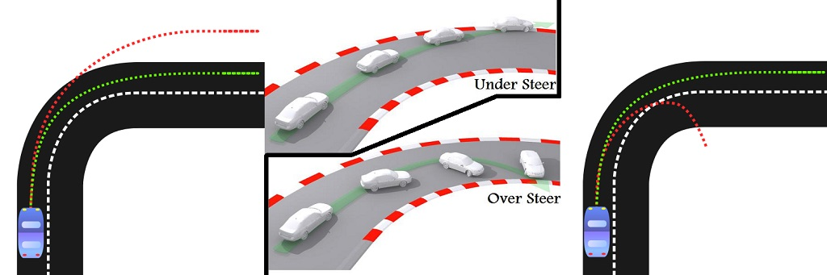
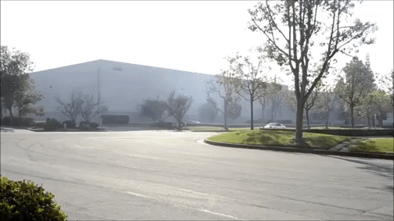
Understeer
Occurs when front wheels lose traction while the rear wheels maintain grip
Advantages:
  “Safe way out”: car will not slide out
  Easier to correct than oversteer
Disadvantages:
  Not for performance, slower corners
  Less fun!

Slide 46
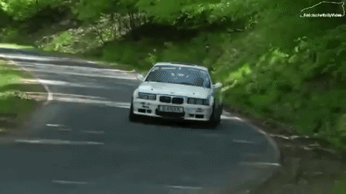
Oversteer
Occurs when rear wheels lose traction while the front wheels maintain grip
Advantages:
  Capable drivers able to manipulate turns
  Better performance
  More driver input
Disadvantages:
  Inexperienced drivers may not be able to control

Slide 47
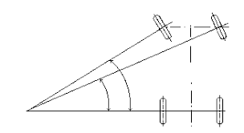
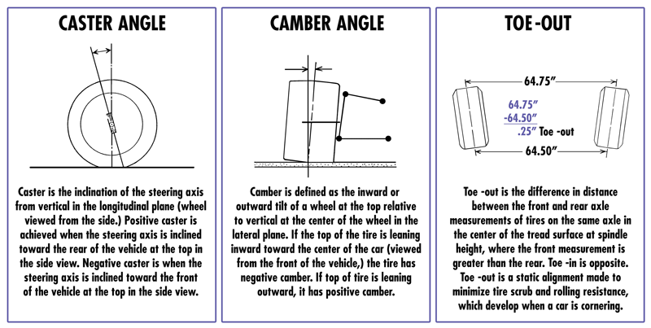
Steering Geometry Terms
Design impacts tire connection with the ground
  Traction
  Maneuverability
  Steering “feel”
  Tire wear
Ackerman
Should consider all when designing steering geometry
Caster
Camber
Toe (from top)

Slide 48
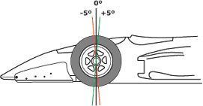
Terms - Caster
Balance steering effort, high speed stability and front end cornering effectiveness
Positive caster:
  Increase steering effort and straight line tracking
  Improve high speed stability and cornering effectiveness

Slide 49
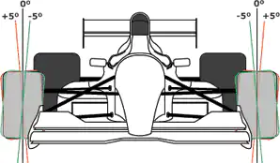
Terms - Camber
Want even wear on straights but more grip on turns
Negative camber: more cornering grip and longer tire life
  Vehicle can “feel nervous” and be more susceptible to tramlining
Appropriate settings take driver and vehicle aggressiveness into account
  Balance treadwear with cornering performance
Tramlining- tendency of a vehicle's wheels to follow the contours in the surface upon which it runs

Slide 50
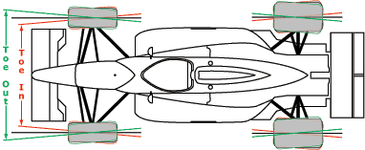
Terms - Toe
Enhance tire wear and adjust vehicle handling
Toe-in: reduced oversteer (increased stability)
Toe-out: reduced understeer (free up car)
Could cause instability
if one tire loses
traction
(“feels nervous”)
Increased tire wear
with toe

Slide 51
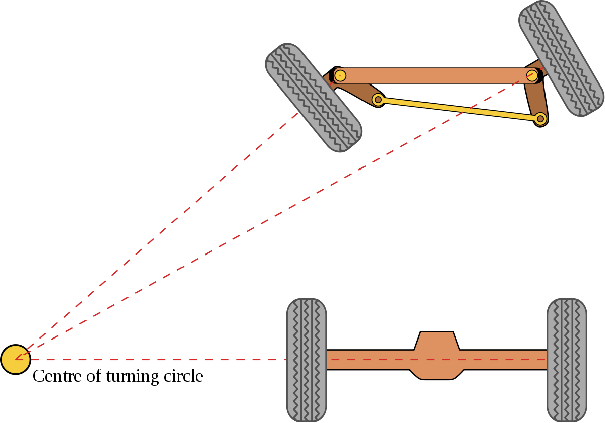
Terms - Ackerman
Front wheels independently steerable
Inside wheel turns with greater angle than outside wheel
Reduced tire slip and wear
Tighter turn radius

Slide 52
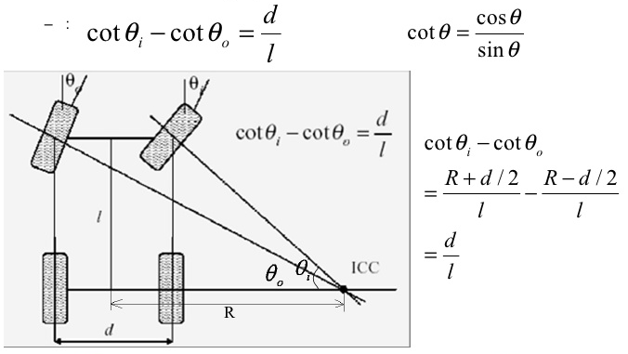
Designing for Ackerman
Determine steering dimensions from vehicle dimensions and desired turning radius
  Or determine turning radius from vehicle and steering dimensions
Can be done on programs like Lotus Shark
Determines steering properties

Slide 53
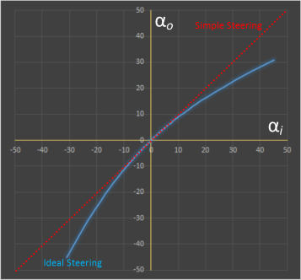
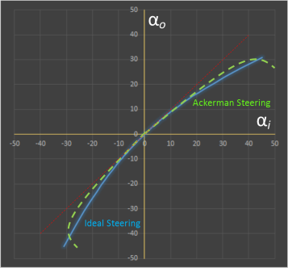
Ackerman
Ackerman closer to ideal steering (no slip) than simple steering (front wheel fixed to same rotation)

Slide 54
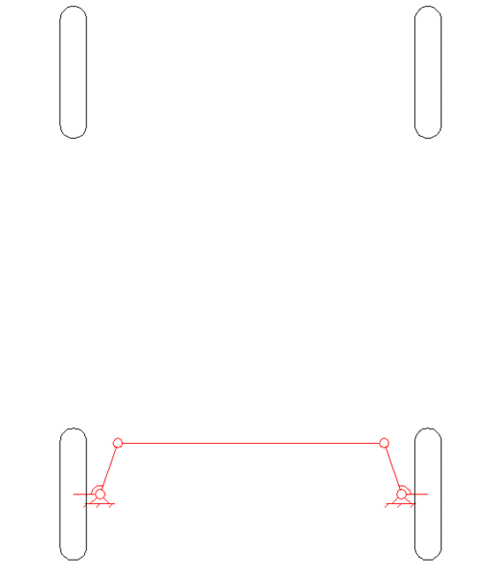
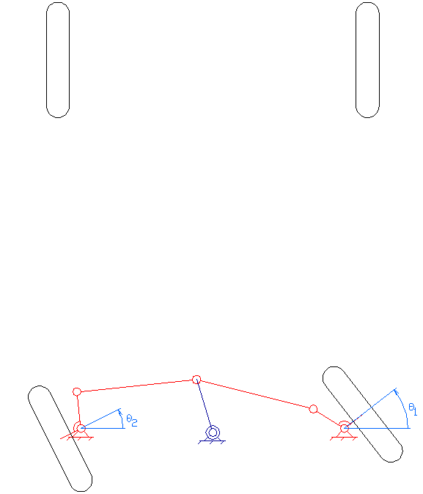
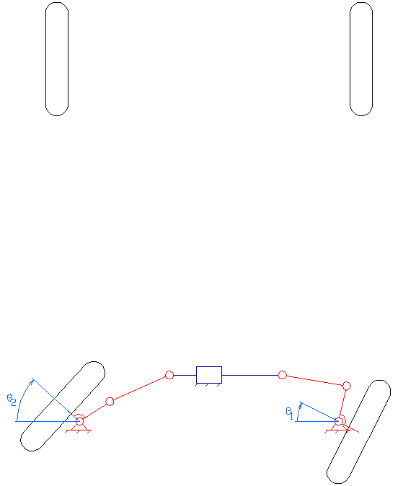
Common Geometries
Ackerman Steering
Bell-Crank Steering
Rack-and-Pinion Steering

Slide 55
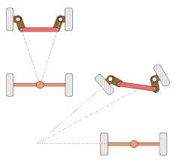
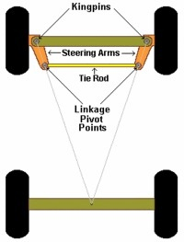
Ackerman Steering
Very simple design from 1818
Focus on Ackerman property
Reduces tire slip
Not common because it ignores other steering properties

Slide 56

Bell-Crank
Not common, but found in aircraft control systems and automotive applications (common in quads)
Strong, but limited to 1:1 ratio
  Requires significant driver force to turn, or another steering gear reduction
  Or handlebars instead of steering wheel
Cool video of a bell-crank on an RC car
(first 0:20 seconds)

Slide 57


Rack-and-Pinion
Most common type on cars, small trucks and SUVs (and Baja)
Rotation of steering wheel -> rotates steering column -> rotates pinion -> pushes rack -> tie rods push tires
Pinion provides gear reduction (easier to turn steering wheel)
  Lower steering ratio: quicker response
Jill Steering Box

Slide 58


Recirulating-Ball
Common on trucks and SUVs
Steering wheel rotates worm gear inside rack -> forces threaded rack to move -> gear teeth on the side move pitman arm -> pushes tie rods to turn tires
Ball bearings between worm gear and rack teeth: reduce friction and slop

Slide 59

Baja Steering
Unique challenge: needs to be maneuverable, strong, lightweight, reliable, cost sensitive, have high turning radius, conform to Baja regulations
Design gear reduction, shape from suspension points, box shape, turning radius (calculated from
ackerman angles), determine
materials/BOM, etc.
  Considerations: mounting,
  assembly/manufacturing,
  interference, etc.
Jill Steering Box

Slide 60


Design Consequences
Unwanted understeer/oversteer
Steering slop (causes lag between driver input and response)
Expensive
Heavy
Difficult to assemble/manufacture or repair
Does not meet goals or constraints
  Poor performance

Slide 61

Other Stuff -Power Steering
Heavy vehicle: either difficult to turn steering wheel or low geared steering (many turns required to rotate)
Pump supplies high pressure oil to rack or steering box
  Oil pushes piston that aids in pushing steering
  Valve closes when driver stops turning the wheel

Slide 62


Other Stuff - 4 Wheel Steering
As name implies, all four wheels turn
Increased agility and stability
Advantages:
  Smaller turning radius
  Better stability
  Quicker steering response
  Safer
Disadvantages:
  Malfunction is common
  Expensive

Slide 63
Questions?

Slide 64
References
“Ackerman Steering.” Data Genetics, datagenetics.com/blog/december12016/index.html.
“How the Steering System Works.” How a Car Works, How a Car Works, www.howacarworks.com/basics/how-the-steering-system-works.
Koladia, Dipalkumar. “Mathematical Model to Design Rack And Pinion Ackerman Steering Geomtery.” International Journal of Scientific &amp; Engineering Research, vol. 5, no. 9, Sept. 2014, doi:10.14299/000000.
https://www.tirerack.com/tires/tiretech/techpage.jsp?techid=4
https://oards.com/four-wheel-steering-system-info/
https://scholarsarchive.byu.edu/cgi/viewcontent.cgi?article=1063&context=studentpub_uht

